Slide 1
DREAM:Lab Graph Subgroup Meeting – 3 Query Models, ICM Logic & Indexing Ideas
Shriram R
26-Aug-19

Slide 2
Query Model – Basic Concepts
Temporal Concepts
Time Domain (Linearly Ordered Discrete)
Time Interval (E.g. [5, 10))
Interval Relations (Before, After, Meets, Intersects, equals)
Temporal Property Graph Model
Finite set of vertices and directed edges with unique identifiers
Both vertices and edges have an associated lifespan
Finite set of properties can be associated with vertices and/or edges
Uniqueness, Referential integrity and Constant edge association requirements

Slide 3
Query Model – Example Graph
[5, 100)
Bob
[10, 20)
[60, 80)
W : 5
W : 10
Alice
Dan
[0, 50)
[30, 50)
W : 20
[40, 90)
W : 10
W : 30
[30, 50)
Chen
[50, 60)
[20, 80)

Slide 4
Query Model - Classes
Reachability
Existence and enumeration of time respecting path(s)
Predicates on Source and Sink vertices
Optimization – Arrival time and/or length (distance) of the path
Constraints – Maximum time and length
Path
Linear chain paths of fixed length
Predicates for each vertex and edge on the path
Allows temporal relationship constraints between adjacent edges

Slide 5
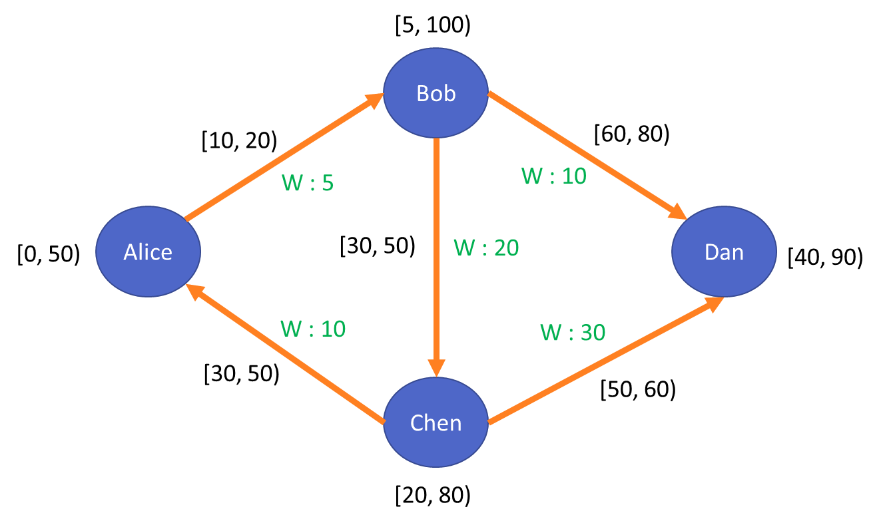
Query Model - Examples
Query Type | Example
Reachability | reach=vid==Alice->vid==Dan::length::100::100::true
 | reach=vid==Alice->vid==Dan::time::100::100:true
Path | path=T==[0,50)->*::before::*->W>=5::*::vid==Dan
 | path=vid==Chen<->W<=20::before::*<->*::*::*
Query Type | Result
Reachability | <true, {(Alice(10)->(5)Bob(60)->(10)Dan(60))}>
 | <true, {(Alice(10)->(5)Bob(30)->(20)Chen(50)->(30)Dan(50))}>
Path | Alice->Bob->Dan
 | Chen<-Bob->Dan

Slide 6
ICM Logic - Reachability
Helper Functions
isSource() – Based on source predicate in the query
isSink() - Based on sink predicate in the query
getOptCriteria() – Time and/or length
getTimeLimit() – Max. time limit from the query
getDisLimit() – Max. distance limit from the query
Vertex State
For each identified source vertex, store
Optimum distance from source
Optimum arrival time from source
Nodes and edges present in the Optimum path

Slide 7
ICM Logic - Reachability
Init method
Initialize the state for each vertex
The list of sources is unknown at this point
Compute method
If getSuperstep() == 1 && isSource(v) then
Add source to the state with distance and time set to 0
For each received message m
Update the distance, time and path if message has lower value compared to the state

Slide 8
ICM Logic - Reachability
Scatter method
Let edge’s temporal validity be [s, e) and weight be w
For each source vertex V in state
If time && distance is within maximum constraints && time < e
New message to neighbouring vertex
Source = V
Arrival_time = max(time, s)
Total_distance = distance + w
Paths = path + edge
After algorithm completion
Vertices having isSink() to True will have the required result for reachability

Slide 9
Reachability – Indexing Ideas
Indexing Classes
Transitive Closure [2]
Store information about all reachable vertices from each vertex
2-Hop Labelling [3]
Store two sets In and Out with each vertex containing information about vertices that can reach and that are reachable from a given vertex
Label + Search [6]
Approximate 2-Hop labelling combined with recursive search and expansion
Label + Search offers good trade off between index construction time, size and query time

Slide 10
Reachability – Indexing Ideas
Label + Search Technique
Associate labels of reachable vertices along with shortest path information
E.g For a vertex V, Labels would look like
{
(A, T: (5, TPaths) D: (20, Dpaths))
(B, T: (3, TPaths) D: (10, DPaths))
}
Constraints on the index w.r.t. to size and/or construction time
Size – Limit no. of labels for each vertex (1-hop, 2-hop etc.)
Time – Timeout for each vertex during construction time

Slide 11
Reachability – Indexing Ideas
Using Label+Search in ICM model
If sink is present as part of source vertex’s label, we are done
Else, send message to reachable labels with path, time and distance information
This step skips the path search till the reachable labels thereby possibly decreasing the no. of supersteps
Alice
Bob
Chen
Dan
Ed
Gru

Slide 12
ICM Logic – Path Query
Helper Functions
getVertexPredicate(i) – Predicate for ith vertex in the chain
getEdgePredicate(i) – Predicate for ith edge in the chain
Vertex State
Partitioned into different index positions in the chain
For each index position
Store previous vertex and edge information
Can be a list if there are multiple previous vertex and edge

Slide 13
ICM Logic - Path
Init method
Initialize state for all indices
Compute method
In the first superstep, each vertex checks if they match first predicate for different time intervals and updates the state for valid time intervals
In the ith superstep, each vertex processes messages from vertices matching with (i-1)th vertex in chain and checks for ith vertex predicate match
Essence – In each superstep we grow the chain by maximum one vertex

Slide 14
ICM Logic - Path
Scatter
If the vertex is identified as a ith vertex in the chain for a particular interval,
For each outgoing edge E,
Check for predicate match for the edge and If matches
Send a message to neighbouring vertex
Index = i
Edge = E
After n supersteps, (n – no. of vertices in query)
Send message from ith vertex to i-1th vertex in the chain for i from n to 2
Constructs the chain in the 1st vertex for output

Slide 15
Path Query – Indexing Ideas
Divide the input chain into small fragments
E.g. 2 vertices and 1 edge (Alice->Bob)
Build an index which can efficiently answer with list of actual graph fragments that satisfies an arbitrary query fragment
Perform Join operation on adjacent set of graph fragments and construct the result
Alice
Bob
Chen
Dan
Ed
Gru

Slide 16
Path Query – Indexing Ideas
Inspired from [7]
For a fixed radius ‘r’ from a vertex, associate bloom filters
For each property label – Time combination,
Bloom filter indicating the presence of values
Bloom filters help prune the search space
Inspired from GoDB / Horton+,
Split the query recursively on points where possible candidates are estimated to be minimum
No. of candidates estimated from an index on predicates
Join the result recursively to construct the final chain

Slide 17
References
Wu, Huanhuan, et al. "Reachability and time-based path queries in temporal graphs." 2016 IEEE 32nd International Conference on Data Engineering (ICDE). IEEE, 2016.
Jagadish, H. V. "A compression technique to materialize transitive closure." ACM Transactions on Database Systems (TODS) 15.4 (1990): 558-598.
Cohen, Edith, et al. "Reachability and distance queries via 2-hop labels." SIAM Journal on Computing 32.5 (2003): 1338-1355.
K. Semertzidis, E. Pitoura, and K. Lillis, “Timereach: Historical reachability queries on evolving graphs.” in EDBT, 2015, pp. 121–132.
H. Yildirim, V. Chaoji, and M. J. Zaki, “Grail: Scalable reachability index for large graphs,” Proceedings of the VLDB Endowment, vol. 3, no. 1-2, pp. 276–284, 2010.
S. Seufert, A. Anand, S. Bedathur, and G. Weikum, “Ferrari: Flexible and efficient reachability range assignment for graph indexing,” in 2013 IEEE 29th International Conference on Data Engineering (ICDE). IEEE, 2013, pp. 1009–1020.
Semertzidis, Konstantinos, and Evaggelia Pitoura. "Top-$ k $ Durable Graph Pattern Queries on Temporal Graphs." IEEE Transactions on Knowledge and Data Engineering 31.1 (2018): 181-194.
Byun, Jaewook, Sungpil Woo, and Daeyoung Kim. "ChronoGraph: Enabling temporal graph traversals for efficient information diffusion analysis over time." IEEE Transactions on Knowledge and Data Engineering (2019).

